Slide 1


CSB4201 - DESIGN AND ANALYSIS AND ALGORITHMS
B.Tech – III Semester – Unit IV
Dr. J. Thangakumar
Associate professor
School of Computing Sciences,
Department of Computer Science and Engineering

Slide 2
Lecture 37 Topic : Graphs

Slide 3
Graph Traversal
Many problems require processing all graph vertices (and edges) in systematic fashion
Graph traversal algorithms:
Depth-first search (DFS)
Breadth-first search (BFS)

Slide 4
Depth-First Search (DFS)
Visits graph’s vertices by always moving away from last visited vertex to an unvisited one, backtracks if no adjacent unvisited vertex is available.
Recurisve or it uses a stack
a vertex is pushed onto the stack when it’s reached for the first time
a vertex is popped off the stack when it becomes a dead end, i.e., when there is no adjacent unvisited vertex
“Redraws” graph in tree-like fashion (with tree edges and back edges for undirected graph)

Slide 9
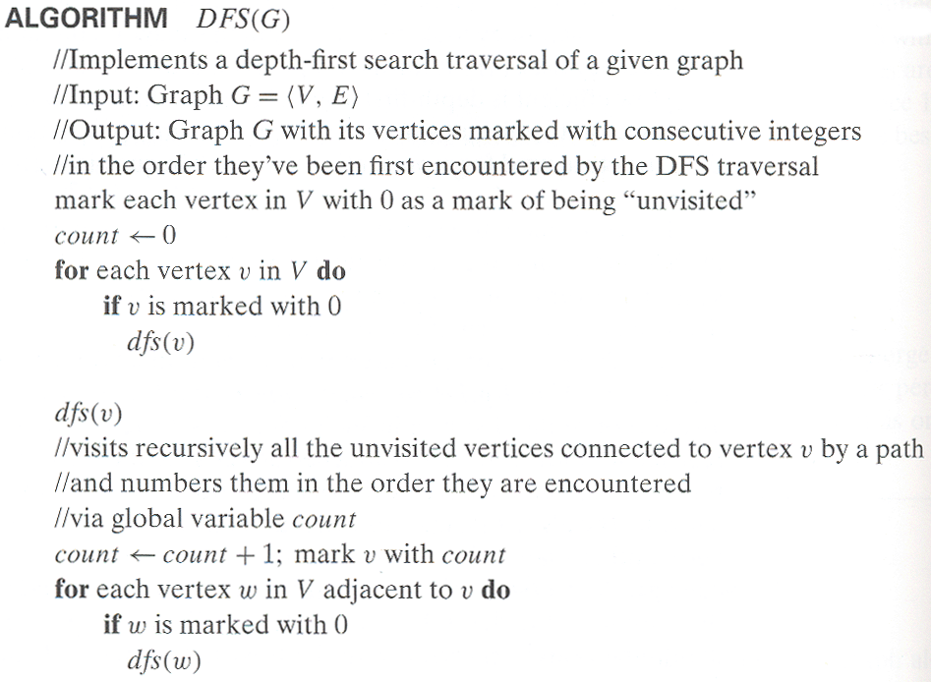
Pseudocode of DFS

Slide 11
Example: DFS traversal of undirected graph
a
b
c
d
a
ab
abf
abfe
abf
ab
abg
abgc
abgcd
abgcdh
abgcd
…
e
f
g
h
DFS traversal stack:
DFS tree:
1
2
6
7
a
b
c
d
e
f
g
h
4
3
5
8
Red edges are tree edges and white edges are back edges.
Notes:
Traversal using alphabetical order of vertices. Work through this example in detail,
showing the traversal by highlighting edges on the graph and showing how the stack
evolves:
8 h 3
7 d 4 stack shown growing upwards
4 e 1 6 c 5 number on left is order that vertex was pushed onto stack
3 f 2 5 g 6 number on right is order that vertex was popped from stack
2 b 7 overlap is because after e, f are popped off stack, g and c
1 a 8 are pushed onto stack in their former locations.
order pushed onto stack: a b f e g c d h
order popped from stack: e f h d c g b a
* show dfs tree as it gets constructed, back edges

Slide 12
Notes on DFS
DFS can be implemented with graphs represented as:
adjacency matrices: Θ(|V|²). Why?
adjacency lists: Θ(|V|+|E|). Why?
Yields two distinct ordering of vertices:
order in which vertices are first encountered (pushed onto stack)
order in which vertices become dead-ends (popped off stack)
Applications:
checking connectivity, finding connected components
checking acyclicity (if no back edges)
finding articulation points and biconnected components
searching the state-space of problems for solutions (in AI)

Slide 13
Breadth-first search (BFS)
Visits graph vertices by moving across to all the neighbors of the last visited vertex
Instead of a stack, BFS uses a queue
Similar to level-by-level tree traversal
“Redraws” graph in tree-like fashion (with tree edges and cross edges for undirected graph)

Slide 14
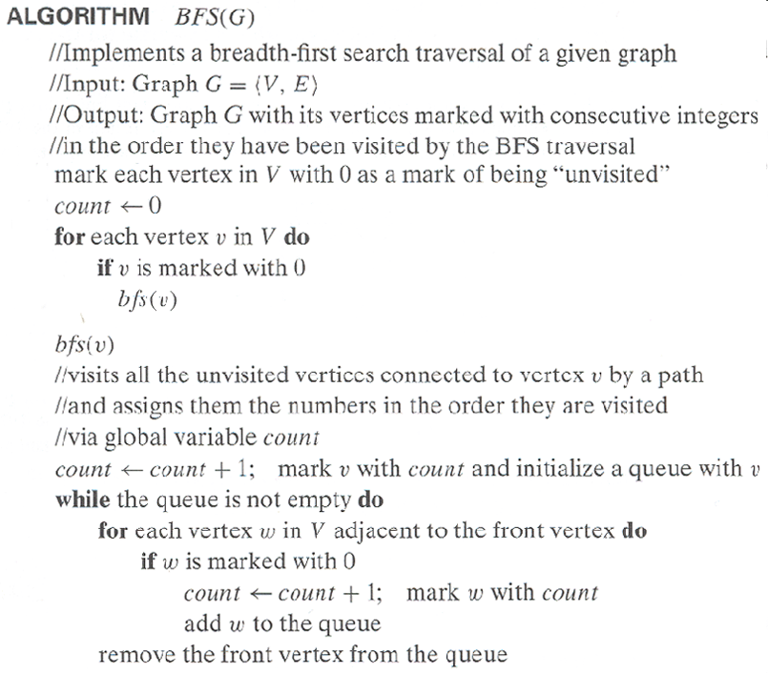
Pseudocode of BFS

Slide 16
Example of BFS traversal of undirected graph
a
b
c
d
a
bef
efg
fg
g
ch
hd
d
e
f
g
h
BFS traversal queue:
BFS tree:
1
2
6
8
a
b
c
d
e
f
g
h
3
4
5
7
Red edges are tree edges and white edges are cross edges.

Slide 17
Notes on BFS
BFS has same efficiency as DFS and can be implemented with graphs represented as:
adjacency matrices: Θ(|V|²). Why?
adjacency lists: Θ(|V|+|E|). Why?
Yields single ordering of vertices (order added/deleted from queue is the same)
Applications: same as DFS, but can also find paths from a vertex to all other vertices with the smallest number of edges

Slide 18
DAGs and Topological Sorting
A dag: a directed acyclic graph, i.e. a directed graph with no (directed) cycles
Arise in modeling many problems that involve prerequisite
constraints (construction projects, document version control)
Vertices of a dag can be linearly ordered so that for every edge its starting vertex is listed before its ending vertex (topological sorting). Being a dag is also a necessary condition for topological sorting to be possible.
a
b
a
b
a dag
not a dag
c
d
c
d

Slide 19
Topological Sorting Example
Order the following items in a food chain
tiger
human
fish
sheep
shrimp
plankton
wheat

Slide 20
DFS-based Algorithm
DFS-based algorithm for topological sorting
Perform DFS traversal, noting the order vertices are popped off the traversal stack
Reverse order solves topological sorting problem
Back edges encountered?→ NOT a dag!
Example:
Efficiency: The same as that of DFS.
b
a
c
d
e
f
g
h

Slide 21
Source Removal Algorithm
Source removal algorithm
Repeatedly identify and remove a source (a vertex with no incoming edges) and all the edges incident to it until either no vertex is left or there is no source among the remaining vertices (not a dag)
Example:
Efficiency: same as efficiency of the DFS-based algorithm, but how would you identify a source? How do you remove a source from the dag?
Source removal algorithm
Repeatedly identify and remove a source (a vertex with no incoming edges) and all the edges incident to it until either no vertex is left or there is no source among the remaining vertices (not a dag)
Example:
Efficiency: same as efficiency of the DFS-based algorithm, but how would you identify a source? How do you remove a source from the dag?
a
b
c
d
e
f
g
h
“Invert” the adjacency lists for each vertex to count the number of incoming edges by going thru each adjacency list and counting the number of times that each vertex appears in these lists. To remove a source, decrement the count of each of its neighbors by one.

Slide 22
Activity https://visualgo.net/en

Slide 24
Lecture 38 Topic : Dijkstra’s algorithm

Slide 25
Shortest paths – Dijkstra’s algorithm
Single Source Shortest Paths Problem: Given a weighted
connected (directed) graph G, find shortest paths from source vertex s
to each of the other vertices
Dijkstra’s algorithm: Similar to Prim’s MST algorithm, with
a different way of computing numerical labels: Among vertices
not already in the tree, it finds vertex u with the smallest sum
d_{v} + w(v,u)
where
v is a vertex for which shortest path has been already found on preceding iterations (such vertices form a tree rooted at s)
d_{v} is the length of the shortest path from source s to v w(v,u) is the length (weight) of edge from v to u

Slide 29
Example
b
4
c
3
6
7
2
5
4
a
d
d
e
Tree vertices Remaining vertices
a(-,0) b(a,3) c(-,∞) d(a,7) e(-,∞)
4
b
c
3
2
6
5
a
7
d
4
e
b(a,3) c(b,3+4) d(b,3+2) e(-,∞)
b
4
c
3
6
2
5
a
7
d
4
e
d(b,5) c(b,7) e(d,5+4)
b
4
c
3
6
2
5
a
7
d
4
e
c(b,7) e(d,9)
4
b
c
3
6
2
5
a
7
d
4
e
e(d,9)

Slide 30
Notes on Dijkstra’s algorithm
Correctness can be proven by induction on the number of vertices.
Doesn’t work for graphs with negative weights (whereas Floyd’s algorithm does, as long as there is no negative cycle). Can you find a counterexample for Dijkstra’s algorithm?
Applicable to both undirected and directed graphs
Efficiency
O(|V|²) for graphs represented by weight matrix and array implementation of priority queue
O(|E|log|V|) for graphs represented by adj. lists and min-heap implementation of priority queue
Don’t mix up Dijkstra’s algorithm with Prim’s algorithm! More details of the algorithm are in the text and ref books.
We prove the invariants: (i) when a vertex is added to the tree, its correct distance is calculated and (ii) the distance is at least those of the previously added vertices.

Slide 32
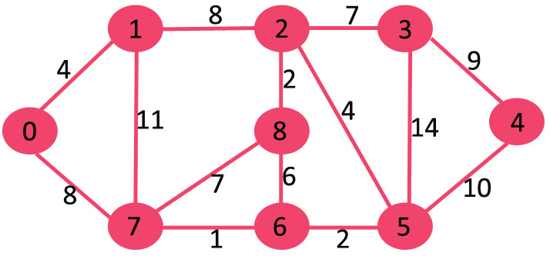

Slide 37
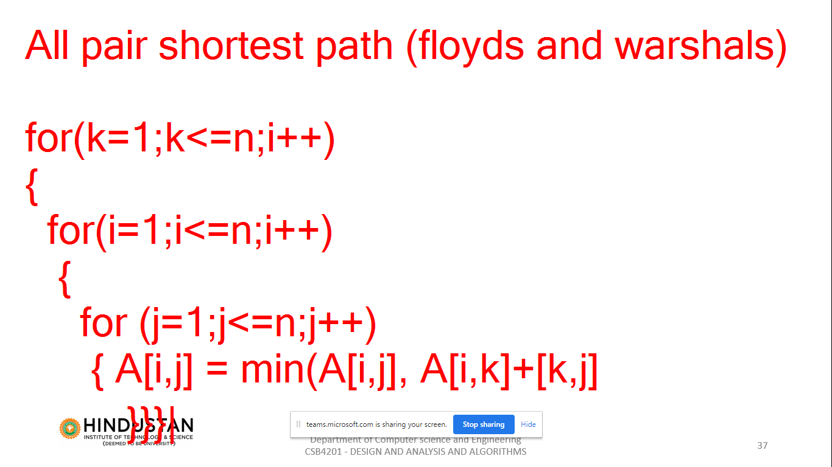

Slide 38
Activity https://visualgo.net/en

Slide 39
Lecture 39 Topic : Floyd Algorithm

Slide 40
Floyd’s Algorithm: All pairs shortest paths
Problem: In a weighted (di)graph, find shortest paths between every pair of vertices
Same idea: construct solution through series of matrices D⁽⁰⁾, …, D ^{(n)} using increasing subsets of the vertices allowed as intermediate
Example:
4
3
1
0 ∞ 4 ∞
1 0 4 3 ∞ ∞ 0 ∞
6 5 1 0
1
6
1
5
4
2
3

Slide 41
Floyd’s Algorithm (matrix generation)
On the k-th iteration, the algorithm determines shortest paths between every pair of vertices i, j that use only vertices among 1,…,k as intermediate
D^{(k)}[i,j] = min {D^{(k-1)}[i,j], D^{(k-1)}[i,k] + D^{(k-1)}[k,j]}
D^{(k-1)}[i,k]
k
i
D^{(k-1)}[k,j]
D^{(k-1)}[i,j]
Initial condition?
j

Slide 42
Floyd’s Algorithm (example)
2
1
2
0 ∞ 3 ∞ 2 0 ∞ ∞
∞ 7 0 1
6 ∞ ∞ 0
0 ∞ 3 ∞
2 0 5 ∞
∞ 7 0 1
6 ∞ 9 0
3
6
7
D⁽⁰⁾ ⁼
D⁽¹⁾ ⁼
3
1
4
0 ∞ 3 ∞
2 0 5 ∞
9 7 0 1
6 ∞ 9 0
0 10 3 4
2 0 5 6
9 7 0 1
6 16 9 0
0 10 3 4
2 0 5 6
7 7 0 1
6 16 9 0
D⁽²⁾ ⁼
D⁽³⁾ ⁼
D⁽⁴⁾ ⁼

Slide 43
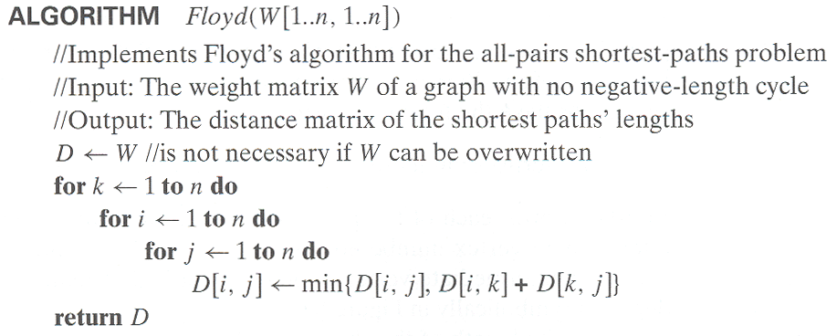
Floyd’s Algorithm (pseudocode and analysis)
If D[i,k] + D[k,j] < D[i,j] then P[i,j] ← k
Since the superscripts k or k-1 make no difference to D[i,k] and D[k,j].
Time efficiency: Θ(n³)
Space efficiency: Matrices can be written over their predecessors
Note: Works on graphs with negative edges but without negative cycles. Shortest paths themselves can be found, too. How?

Slide 44
Lecture 40 Topic : Warshalls Algorithm

Slide 45
Warshall’s Algorithm: Transitive Closure
Computes the transitive closure of a relation
Alternatively: existence of all nontrivial paths in a digraph
Example of transitive closure:
3
3
1
1
4
4
0 0 1 0
1 1 1 1
0 0 0 0
1 1 1 1
2
0 0 1 0
1 0 0 1
0 0 0 0
0 1 0 0
2

Slide 46
Warshall’s Algorithm
Constructs transitive closure T as the last matrix in the sequence of n-by-n matrices R⁽⁰⁾, … , R^{(k)}, … , R^{(n)} where
R^{(k)}[i,j] = 1 iff there is nontrivial path from i to j with only the first k vertices allowed as intermediate
Note that R⁽⁰⁾ = A (adjacency matrix), R^{(n)} = T (transitive closure)
3
3
3
3
3
1
1
1
1
1
4
4
4
2
4
4
2
2
2
2
R⁽⁰⁾
0 0 1 0
1 0 0 1
0 0 0 0
0 1 0 0
R⁽¹⁾
0 0 1 0
1 0 1 1
0 0 0 0
0 1 0 0
R⁽²⁾
0 0 1 0
1 0 1 1
0 0 0 0
1 1 1 1
R⁽³⁾
0 0 1 0
1 0 1 1
0 0 0 0
1 1 1 1
R⁽⁴⁾
0 0 1 0
1 1 1 1
0 0 0 0
1 1 1 1

Slide 47
Warshall’s Algorithm (recurrence)
On the k-th iteration, the algorithm determines for every pair of vertices i, j if a path exists from i and j with just vertices 1,…,k allowed as intermediate
R^{(k-1)}[i,j] (path using just 1 ,…,k-1)
R^{(k)}[i,j] = or
R^{(k-1)}[i,k] and R^{(k-1)}[k,j] (path from i to k
and from k to j
using just 1 ,…,k-1)
{
k
i
Initial condition?
j

Slide 48
Warshall’s Algorithm (matrix generation)
Recurrence relating elements R^{(k)} to elements of R^{(k-1)} is:
R^{(k)}[i,j] = R^{(k-1)}[i,j] or (R^{(k-1)}[i,k] and R^{(k-1)}[k,j])
It implies the following rules for generating R^{(k)} from R^{(k-1)}:
Rule 1 If an element in row i and column j is 1 in R^{(k-1)}, it remains 1 in R^{(k)}
Rule 2 If an element in row i and column j is 0 in R^{(k-1)}, it has to be changed to 1 in R^{(k)} if and only if the element in its row i and column k and the element
in its column j and row k are both 1’s in R^{(k-1)}

Slide 49
Warshall’s Algorithm (example)
3
0 0 1 0
1 0 0 1
0 0 0 0
0 1 0 0
0 0 1 0
1 0 1 1
0 0 0 0
0 1 0 0
1
R⁽⁰⁾ ⁼
R⁽¹⁾ ⁼
2
4
0 0 1 0
1 0 1 1
0 0 0 0
1 1 1 1
0 0 1 0
1 0 1 1
0 0 0 0
1 1 1 1
0 0 1 0
1 1 1 1
0 0 0 0
1 1 1 1
R⁽²⁾ ⁼
R⁽³⁾ ⁼
R⁽⁴⁾ ⁼

Slide 50
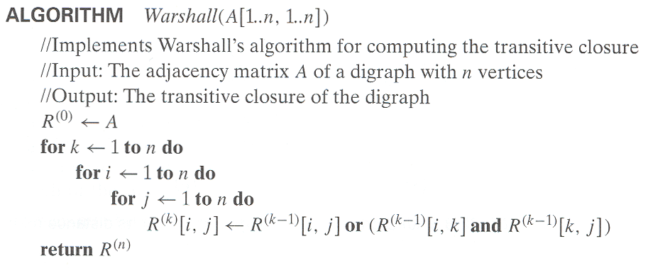
Warshall’s Algorithm (pseudocode and analysis)
Time efficiency: Θ(n³)
Space efficiency: Matrices can be written over their predecessors
(with some care), so it’s Θ(n^2).

Slide 59
Lecture 41 Topic : Minimum Cost Spanning Tree

Slide 60
Minimum Spanning Tree (MST)
Spanning tree of a connected graph G: a connected acyclic subgraph of G that includes all of G’s vertices
Minimum spanning tree of a weighted, connected graph G: a spanning tree of G of the minimum total weight
Example:
6
c
6
c
c
a
a
a
4
1
4
1
1
2
2
d
d
d
b
3
b
b
3

Slide 61
Prim’s MST algorithm
Start with tree T₁ consisting of one (any) vertex and “grow” tree one vertex at a time to produce MST through a series of expanding subtrees T₁, T₂, …, T_{n}
On each iteration, construct T_{i+1} from T_{i} by adding vertex not in T_{i} that is closest to those already in T_{i} (this is a “greedy” step!)
Stop when all vertices are included

Slide 62
Example
4
c
4
c
4
c
a
a
a
1
1
1
6
6
6
2
2
2
d
d
d
b
3
b
3
b
3
4
c
4
c
a
a
1
1
6
6
2
2
d
d
b
3
b
3

Slide 63
Notes about Prim’s algorithm
Proof by induction that this construction actually yields an MST (CLRS, Ch. 23.1). Main property is given in the next page.
Needs priority queue for locating closest fringe vertex. The Detailed algorithm can be found in Levitin, P. 310.
Efficiency
O(n²) for weight matrix representation of graph and array implementation of priority queue
O(m log n) for adjacency lists representation of graph with n vertices and m edges and min-heap implementation of the priority queue

Slide 64
The Crucial Property behind Prim’s Algorithm
Claim: Let G = (V,E) be a weighted graph and (X,Y) be a partition of V (called a cut). Suppose e = (x,y) is an edge of E across the cut, where x is in X and y is in Y, and e has the minimum weight among all such crossing edges (called a light edge). Then there is an MST containing e.
Y
y
x
X

Slide 65
Activity https://visualgo.net/en

Slide 66
Lecture 42 Topic : Kruskal’s Algorithm

Slide 67
Another greedy algorithm for MST: Kruskal’s
Sort the edges in nondecreasing order of lengths
“Grow” tree one edge at a time to produce MST through a series of expanding forests F₁, F₂, …, F_{n-1}
On each iteration, add the next edge on the sorted list unless this would create a cycle. (If it would, skip the edge.)

Slide 68
Example
4
c
4
c
4
c
a
a
a
1
1
1
6
6
6
2
2
2
d
d
d
b
3
b
3
b
3
4
c
c
c
a
a
a
1
1
1
6
6
2
2
2
d
d
d
b
3
b
3
b
3

Slide 69
Notes about Kruskal’s algorithm
Algorithm looks easier than Prim’s but is harder to implement (checking for cycles!)
Cycle checking: a cycle is created iff added edge connects vertices in the same connected component
Union-find algorithms – see section 9.2
Runs in O(m log m) time, with m = |E|. The time is mostly spent on sorting.

Slide 70
Activity https://visualgo.net/en

